Slide 1
Pre-assessment Questions
  ______ is the feature of OOPS that implies that the non-essential details of an object are hidden from the user and an access is provided to its essential details.
  a. Inheritance
b. Abstraction
c. Polymorphism
d. Encapsulation
  2. What is the relationship between objects of a superclass and subclass known as?.
a. Kind-Of
b. Abstraction
c. Part-Of
  d. Has-A

Slide 2
Pre-assessment Questions (Contd.)
  Identify the feature of OOPS that means ignoring the non-essential details of an object and concentrating on its essential features?
    Inheritance
    Encapsulation
    Abstraction
    Polymorphism
  What is the type of inheritance in which a subclass is derived from more than one super class known as?
    Single Inheritance
    Multiple Inheritance
    Multilevel Inheritance
    Hybrid Inheritance

Slide 3

Pre-assessment Questions (Contd.)
  5. Identify the type of relationship shared by the Gear and Automobile class in the given figure.
    Part-of
    Has-a
    Kind-of
    Is-a

Slide 4
Solutions to Pre-assessment Questions
  d.
  b.
  c.
  b.
  a

Slide 5
Objectives
  In this lesson, you will learn about:
    Concepts of Java programming language
    Variables
    Arrays

Slide 6
Java Programming Language
  Need for Java
    Java applications are:
      Character User Interface (CUI) Applications:Has access to the system resources, such as file systems and can read and write to files on local computers.
      Graphical User Interface (GUI) Applications: Used in the Windows environment.
      Applets: Are small executable programs that run on a Web page and require a Java-enabled browser, such as Internet Explorer or Netscape Navigator.
      Servlets:Are the programs that are used to extend the functionality of Web servers.
      Packages:Are collection of classes that can be reused by applications and applets.

Slide 7
Java Programming Language (Contd.)
  Characteristics of Java
    Simple
    Object-oriented
    Compiled and interpreted
    Portable
    Distributed
    Secure

Slide 8
Java Programming Language (Contd.)
  Java Architecture
    Various components of Java Architecture are:
      Java programming language
      Java class file
      Java Virtual Machine (JVM)
      Java Application Programming Interface (API)

Slide 9

Java Programming Language (Contd.)
  Java Programming Language and class File
    The Java programming environment

Slide 10
Java Programming Language (Contd.)
  Java Virtual Machine (JVM)
    Components of the JVM:
      Class loader
      Execution engine
      Just In Time(JIT) compiler

Slide 11
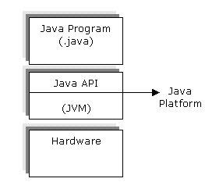
Java Programming Language (Contd.)
  Java Application Programming Interface (API)
    Components of Java platform

Slide 12
Java Programming Language (Contd.)
  Java architecture security features:
    Compiler level security
    Byte code verifier
    Class loader
    Sandbox model

Slide 13
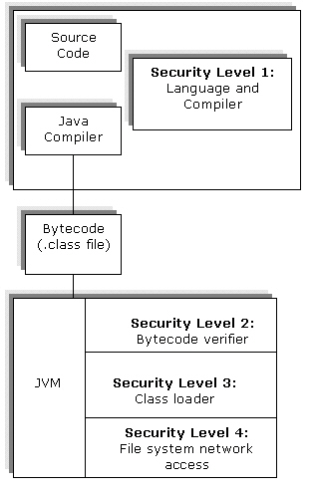
Java Programming Language (Contd.)
  Security levels in Java architecture:

Slide 14
Java Programming Language (Contd.)
  Bytecode is verified in two phases:
    In the first phase, the verifier checks for the structure of the .class file.
    The second level phase occurs when the Bytecode is run.The Bytecode verifier checks the validity of classes, variables, and methods used in a program.

Slide 15
Declaring Variables and Literals
  The various data types in Java are:
    Primitive or the simple data types
    Abstract or the derived data types

Slide 16
Declaring Variables and Literals
(Contd.)
Group
Data Type
Size
Range
Default Value
Integer
byte
One byte
-27 to 2­­7–1 (signed)
0
short
Two byte
-215 to 215 –1
0
int
Four byte
-231 to 231-1
0
long
Eight byte
-263 to 263-1
0

Slide 17
Declaring Variables and Literals
(Contd.)
Group
Data Type
Size
Range
Default Value
Floating point
float
Four byte
3.4e-038 to 3.4e+038
0.0
double
Eight byte
1.7e-308 to 1.7e+308
0.0
Boolean
boolean
One bit
true or false
false
Character
char
Two byte
a single character
null

Slide 18
Declaring Variables and Literals
(Contd.)
  Integer data types and their width and ranges
Data type
Width (Bits)
Range
byte
8
-128 to 127
short
16
-32,768 to 32,767
int
32
-2,147,483,648 to 2,147,483,647
long
64
-9,223,372,036,854, 775,808 to 9,223,372, 036, 854,775,807

Slide 19
Declaring Variables and Literals (Contd.)
  Floating point data types:
    Float:Has a range of 32 bits
    Double:Has a range of 64 bits
  Character data type:
    Has a width of 16-bits
    Has the set of standard ASCII character ranging from 0 to 127

Slide 20
Declaring Variables and Literals (Contd.)
  Abstract data types:
    Data types derived from the primitive data types
    String stores letters, digits, and characters such as as /, (), :, :, $, and #.

Slide 21
Declaring Variables and Literals
(Contd.)
  Keywords available in Java:
abstract | boolean | break | byte
case | catch | char | class
const | continue | default | do
double | else | extends | final
finally | float | for | goto
if | implements | Import | instanceof

Slide 22
Declaring Variables and Literals
(Contd.)
  Keywords available in Java: (Contd.)
int | interface | long | native
new | package | private | protected
public | return | short | static
strictfp | super | switch | synchronized
this | throw | throws | transient
try | void | volatile | while

Slide 23
Declaring Variables and Literals
(Contd.)
  Defining Variables and Literals:
    A variable is the name that refers to a memory location where some data value is stored.
    Each variable that is used in a program must be declared.

Slide 24
Declaring Variables and Literals
(Contd.)
  Naming Conventions for Variables:
    The name of a variable needs to be meaningful, short, and without any embedded space or symbol.
    A variable name must be unique.
    A variable name must begin with a letter, an underscore (_), or the dollar symbol ($), which can be followed by a sequence of letters or digits (0 to 9), ‘$’, or ‘_’ .
    A variable name should not start with a digit.
    A variable name should not contain embedded white spaces .
    A variable name should not consist of a keyword.
    A variable name in Java is case sensitive.

Slide 25
Declaring Variables and Literals
(Contd.)
  Types of Variables:
    Class variables
    Instance variables
    Local variables
    Static variables
    Automatic variables

Slide 26
Declaring Variables and Literals
(Contd.)
  Literals in Java:
    Integer literals
    Floating point literals
    Character literals
    String literals
    Boolean literals

Slide 27
Declaring Variables and Literals
(Contd.)
  Manipulating Variables:
      Assignment Operator
        You use the assignment operator (=) to assign a value to a variable.

Slide 28
Declaring Variables and Literals
(Contd.)
Operator
Operation
+
Adds two operands
-
Subtracts one operand from another”
*
Multiplies two operands
/
Divides two operands

Slide 29
Declaring Variables and Literals
(Contd.)
Operator
Operation
%
Calculates the modulus
++
Increments a variable
--
Decrements a variable

Slide 30
Using Arrays
  Arrays:
    One-dimensional arrays
    Multi-dimensional arrays

Slide 31
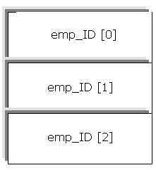
Using Arrays (Contd.)
  Memory allocation to arrays:

Slide 32
Summary
In this lesson, you learned:
  Java is both a language and a technology used to develop desktop and Internet-based applications known as Java applications and applets. 
  The various characteristics of Java programming language
    Simple
    Object-oriented
    Compiled and interpreted
    Portable
    Distributed
    Robust
    Secure
  Various components of the Java architecture are:
    Java programming language
    Java class file
    Java Virtual Machine
    Java Application Programming Interface (API).

Slide 33
Summary(Contd.)
  The JVM converts the bytecode contained in the .class file to machine object code.
  The various data types defined in Java are:
    Integers: Include byte, short, int, and long data types.
    Floating-point numbers: Include double and float data types.
    Characters: Include char, data type.
    Boolean: Include boolean, data type.
  The built-in or the intrinsic data types in Java are known as the primitive or the simple data types.
  The abstract data types include the data types derived from the primitive data types.
  The keywords are the reserved words for a language, which express the language features.

Slide 34
Summary(Contd.)
  A variable is the basic storage unit in Java. It is the name that refers to a memory location where some data value is stored.
  The various types of variables are:
    Class variables
    Instance variable
    Local variables
    Static variables
    Automatic variables
  You use operators in Java to manipulate data and variables. The various operators are assignment and arithmetic operators.
  An array is a group of variables of the same data type and referred to by a common name. A specific element of an array can be accessed by its index. An array is a block of memory locations.

